Slide 1
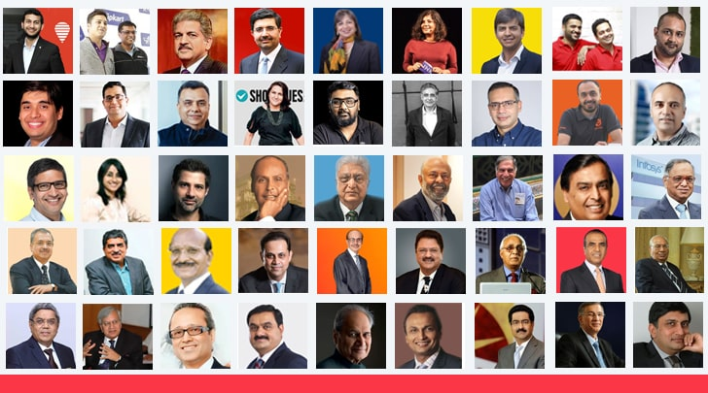

Slide 2

INNOVATION, INCUBATION
AND ENTREPRENEURSHIP

Slide 3
Innovation:
Introducing a new idea, method, product, or improvement that creates value. It is about doing something better, faster, or differently than before.
Incubation:
The process of supporting new business ideas or startups during their early stages. Incubation centers provide guidance, mentoring, funding support, workspace, and training.
Entrepreneurship:
The ability and willingness to start, manage, and grow a business, taking risks to earn profit and create value.

Slide 4

If You have confidence on own strength then you become entrepreneur,
But other have confidence on your strength then you become CEO.

Slide 5

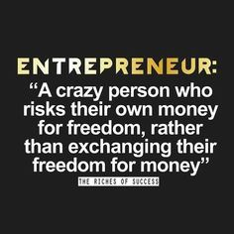

Slide 6
CONCEPT
Enterprise
Is an already formed business organization that propose some goods or services, etc.
Entrepreneur
Is a person who establishes and manages the enterprise. He/she is often the founder of the business.
Entrepreneurship
Is the process of establishing new business enterprise along with the capacity to identify the opportunities and threats and to undertake all the risks to gain profits in results.

Slide 7
CONCEPT
It was the beginning of 18th Century when the word was used to refer to economic aspect
Richard Cantillon is the first one who introduced the term Entrepreneur with some economical aspect
According to him - “Entrepreneur as an agent who buy factors of production at certain price in order to combine them to produce product with a view to selling it in uncertain price in the future” (FARMER)
According to Knight - “Entrepreneur is the economic functionary who undertakes such responsibility of uncertainty which is not insured nor capitalized nor salaried”
Entrepreneur earns profit by bearing uncertainty.

Slide 8
DEFINITION

Slide 9
An individual who bears the risk of operating a business in the face of uncertainty about the future conditions. | Encyclopedia Britannica
He is the one who innovates, and introduces something new in the economy. | Joseph A. Schumpeter
He shifts economic resources out of an area of lower and into an area of higher productivity and greater yield. | J. B. Say (French economist)
He searches for change, responds to it and exploits opportunities. Innovation is the specific tool of an entrepreneur. | Peter F. Drucker
He is the one who is endowed with more than average capacities in the task of organizing and coordinating the various factors of production. He is a pioneer and captain of industry. | Francis A. Walker
He is a critical factor in economic development and an integral part of economic transformation. | William Diamond

Slide 10
Why Should You Become an Entrepreneur?

Slide 11
You will be your own boss and boss to other people and make decisions that are crucial to the business’ success or failure.
You will have the chance to put your ideas into practice.
You will make money for yourself rather than for someone else.
You may participate in every aspect of running a business and learn and gain experience in a variety of disciplines.
You will have the chance to work directly with your customers.
You will have the personal satisfaction of creating and running a successful business.
You will be able to work in a field or area that you really enjoy.
You will have the chance to build retirement value (for example, by selling the business when you retire).

Slide 12
Scope of Entrepreneurship?

Slide 13
1. Contribution to GNP and per capita income:
Entrepreneurship contributes to economic stability by introducing new products
Render services in the market and encouraging effective resource mobilization.
This helps in increasing the gross national product as well as per capita income of the people in the country.
Economic stability leads to increased institutional investment for productive activities and is a sign of economic growth.
2. Employment generation:
Entrepreneurs are not only self-employed but also provide employment to others.
For example, when the information technology boom occurred in India, it led to several successful entrepreneurial ventures. This provided employment to many and also led to the launch of a number of engineering colleges, development of real-estate and hospitality ventures, and infrastructural facilities.

Slide 14
3. Balanced regional development:
The development of enterprises in less-developed regions promotes balanced regional development in the country.
Entrepreneurship stimulates the distribution of wealth and income to more and more individuals (such as stakeholders) and geographical areas, thus benefiting larger sections of society.
4. Promotion of export and trade:
Entrepreneurship promotes the country’s export trade and earns foreign exchange.
This earning can help combat the country’s import dues requirements. International trade brings economic strength.
5. Improvement in the standard of living:
Entrepreneurs bring a wide variety of products and services into the market.
This increases competition in the market and makes it possible for people to avail of a better quality of products and services at lower and more competitive prices, resulting in an improvement of the country’s overall standard of living.

Slide 15
6. Increased innovation:
With the liberalization of the Indian economy, the increased competition in the domestic and international market by giving freedom to the private players has encouraged entrepreneurs to be more creative.
7. Overall development of the economy:
Entrepreneurs create new technologies, products, processes, and services that become the next wave of new industries, and these in turn drive the economy. Entrepreneurs are change agents in society. They create wealth and value, and generate employment in society. This naturally leads to social and economic growth.

Slide 16
Characteristics of an Entrepreneur

Slide 17
Mental ability
An entrepreneur can understand situations quickly, and make smart decisions even under pressure.
Clear objective
They know exactly what they want to achieve and work with a clear goal instead of being confused or directionless.
Business secrecy
They know what information to share and what to keep private, such as business ideas, plans, and strategies.
Human relation ability
An entrepreneur can build good relationships with employees, customers, suppliers, and investors.
Communication ability
They can convince others, and express their thoughts confidently.
Technical knowledge
They understand practical side of their business, whether it is production or service.

Slide 18
Motivator
An entrepreneur encourages and inspires others, especially their team, to work better and stay positive.
Self-confidence
They believe in themselves and their ideas, even when others doubt them.
Long –term involvement
They are committed for the long run, not just for quick profit. They stay focused even during tough times.
High energy level
Entrepreneurs are active, enthusiastic, and hardworking, often working long hours with passion
Persistent problem solver
They do not give up easily. When problems come, they keep trying until they find a solution.
Initiative
They take action on their own instead of waiting for instructions or opportunities to come to them.
Moderate risk-taker
They take calculated risks, not blind risks. They think carefully before making decisions.

Slide 19
Models of Entrepreneurship Development

Slide 20
Theories explain why some people become entrepreneurs and what factors motivate them to start a business.
Psychological Model
David McClelland’s theory
Hagen’s Theory of Withdrawal of Status Respect (1964)
Rotter- Internal–External Locus of Control Theory
Sociological Model
Max Weber’s Theory of Religious Beliefs
Hozelist’s Sociocultural Theory
Thomas Cochran’s Theory of Entrepreneurial Supply
Frank W. Young’s Theory of Group Level Pattern
Integrated Model

Slide 21
1. Psychological Models
The essence of psychological theory is an understanding of the difference in individuals’ attitudes. Some people see problems, while other see opportunities.
According to this theory, the internal attitude and ability to judge and forecast any situation lead a person to become a successful entrepreneur.
This model says that entrepreneurs are created because of their mindset, personality, and inner motivation.

Slide 22
David McClelland’s theory of Achievement motivation
In his theory, McClelland considers entrepreneurs as people who do things in a better way, make decisions in times of uncertainty and Strongly motivated to grow, achieve and succeed.
Three motives for accomplishing things:
Need for Power (nP), or the drive to influence, control and lead others at any given situation.
Need for Affiliation (nAff), or the drive for interpersonal relationship.
Need for Achievement (nAch), or the drive to excel, achieve success and perform better than before.
All of these needs may simultaneously act on an individuals.
Notes:
According to the McClelland, people who have high need for achievement have tendency to win and excel. People who have high need for achievement personally take the responsibility of solving problems and will always try to be better than others. He further explained that people with high need of achievement are more likely to succeed as entrepreneur because it is the need for achievement that motivates and promotes entrepreneurship.
The definite characteristics of a high achiever (entrepreneur) can be listed as follows:
(i) They lay down moderate realistic and achievable goals for them.
(ii) They take planned risks.
(iii) They favor situations wherein they can get individual responsibility for solving problems.
(iv) They need actual feedback on how well they are doing.
(v) Their need for achievement live not only for the sake of economic rewards or social recognition rather personal achievement is essentially more satisfying to them.

Slide 23
Hagen’s Theory of Withdrawal of Status Respect (1964)
Everett Hagen’s concept of the entrepreneur is that of a “creative personality” interested in accelerating change and driven by a motivation to achieve.
According to Hagen, entrepreneurial growth has been very gradual and may or may not even occur in the same generation. In his theory of withdrawal of status respect,
Everett Hagen’s argument is that certain social changes may disrupt the stability of traditional society and cause psychological changes in a group or in an individual.
Notes:
It occurs when the member in the group perceive that their efforts and purposes in the life are not valued by the other members. He proposed four events which can lead to status withdrawal:
Displacement of a conventional best group from its earlier status by another conventional supply physical force.
Defamation of valued symbols through some change in the attitude of the superior group
Inconsistency of status symbols with a changing‟ distribution of economic power.
Acceptance of expected status on migration to a new society.

Slide 24
Rotter- Internal–External Locus of Control Theory
Professor J. D. Rotter of Ohio University in this theory explain how people think about success and failure and what control their life outcomes.
Locus of control determines whether a person perceives a potential goal to be attainable through one’s own actions (internal locus of control) or through uncontrollable external factors (external locus of control).
Internal locus of control believe that success or failure depends on their own efforts. It comprises self-confidence, extreme belief in one’s own ability, and initiatives taken by an individual.
Successful entrepreneurs have internal locus of control. (My business success because of my planning and hard work.)
External locus of control believe that success and failure depends on luck and external environment.(My business fails because of bad luck or government policy changes.)

Slide 25
Sociological Model
Max Weber’s Theory of Religious Beliefs
Hozelist’s Sociocultural Theory
Thomas Cochran’s Theory of Entrepreneurial Supply
Frank W. Young’s Theory of Group Level Pattern

Slide 26
2. Sociological Model
Social cultures to be the driving force behind entrepreneurship. Eg. In Marwari and Gujarati society business and trade are respected.
The entrepreneur becomes a role performer in conformity with the role expectations of society.
Such role expectations are based on religious beliefs, taboos(cultural restrictions- in some society women are restricted for business), and customs(pass on to generation).

Slide 27
Max Weber’s Theory of Religious Beliefs
According to Max Weber, religious beliefs are the driving or restraining forces for entrepreneurial activity.
Religious values like hard work, discipline, honesty, and saving encourage entrepreneurship.
Religious beliefs play a crucial role in determining the attitude of the entrepreneur towards generating or limiting profits.
Weber took the position that entrepreneurial growth is dependent upon the ethical values (due to religion) of society.
Capitalism thrives under the Protestant work ethic that advocates hard work, honesty, and discipline. The spirit of capitalism, coupled with the motive of profit, results in the creation of a large number of successful business enterprises.
Weber distinguished between two types of behavior the “spirit of capitalism” and the “adventurous spirit.” The spirit of capitalism is influenced by a strict discipline and regular profit, whereas the adventurous spirit comes from the free force of impulse take risk, tries new ideas and enter new markets.
Right combination of discipline of capitalism and courage of adventure defines the successful entrepreneur.
Notes:
ax Weber believes that religion has a large impact on the entrepreneurial development of the country because some religion has basic faith to earn more money whereas some has less. He calls them „spirit of capitalism‟ which can be enhanced in the country if there will be favourable attitude towards capitalism in the country. It is the religious beliefs that develop the sense of capitalism in the individual which generates the feeling of occupational chase and the addition of assets.

Slide 28
Hozelist’s Sociocultural Theory
According to Hozelist, a specific social culture leads to growth in entrepreneurship.
Entrepreneurship grows when society respects business, innovation, and leadership.
Social sanctions(rewards and punishment by society), cultural values, and role expectations are responsible for the emergence of entrepreneurship.
If society rewards risk-taking and hard work, entrepreneurship grows and If society discourages failure, people avoid business.
Entrepreneurship grows in societies that permit variability in choice of paths of life.

Slide 29
Thomas Cochran’s Theory of Entrepreneurial Supply
In agreement with Hozelist, believed that the environment in which an individual is brought up determines his entrepreneurial urge.
According to him, the supply of entrepreneurs in society needs to be seen with reference to prevailing child-rearing practices.
Entrepreneurs emerge when society provides: Education, Role models, Social acceptance and Financial support.
He stated that the performance of the entrepreneur might be seen in reference to his own attitudes towards an occupation.
Values and role expectations of the particular social group to which he belongs are the most important determinants in the performance of business entrepreneurial roles.

Slide 30
Frank W. Young’s Theory of Group Level Pattern
Frank W. Young explains how entrepreneurship develops in groups, not just in individuals.
He says social groups, their status, and their support systems play a big role in creating entrepreneurs.
Group can be reactive in two ways: if the group experiences low status recognition and denial of access to important social networks, other with the greater access.
A group without anything will compete with other groups and try to acquire social recognition.
Low status group will lead to entrepreneurial behaviour if the group has better institutional resources(education, finance).
Young’s model of entrepreneurship suggests the creation of supporting institutions in society, such as the education and training, family support, community support, financial institution as the determinant of entrepreneurship.

Slide 31
3. Integrated Models
In search of an integrated approach, the behaviorists tried to synthesize psychology and sociology to explain entrepreneurship.
It looks at personal qualities of a person (psychology) and also the social and environmental conditions (society)
According to T.V. Raos, the optimal presence of the following factors, leads to the initiation of entrepreneurship.
Need for motive
Long term involvement in thought and action to achieve the goal in entrepreneurial activity.
Personal(skills, knowledge and confidence), social(family support and networks) and material resources(land, labor, capital, machinery) favorable to entrepreneurial activity.
Suitable sociopolitical System such as government policies, infrastructure and political stability for the establishment, development, and expansion of an enterprise.

Slide 32
INTRODUCTION TO ENTREPRENEUR AND PROFESSIONAL MANAGERS

Slide 33
Functions of Entrepreneur and Manager in managing organization
Planning- Entrepreneur plans new ideas, vision, and future growth of the business. Manager plans day-to-day activities to achieve set targets.
Organizing- Entrepreneur creates the basic structure of the organization. Manager uses and maintains the existing structure efficiently.
Staffing- Entrepreneur decides manpower needs and key positions. Manager recruits, trains, and supervises employees.
Directing- Entrepreneur provides leadership, inspiration, and motivation. Manager gives instructions, guidance, and supervision.
Controlling- Entrepreneur controls performance at a strategic level. Manager controls daily operations and corrects deviations.

Slide 34
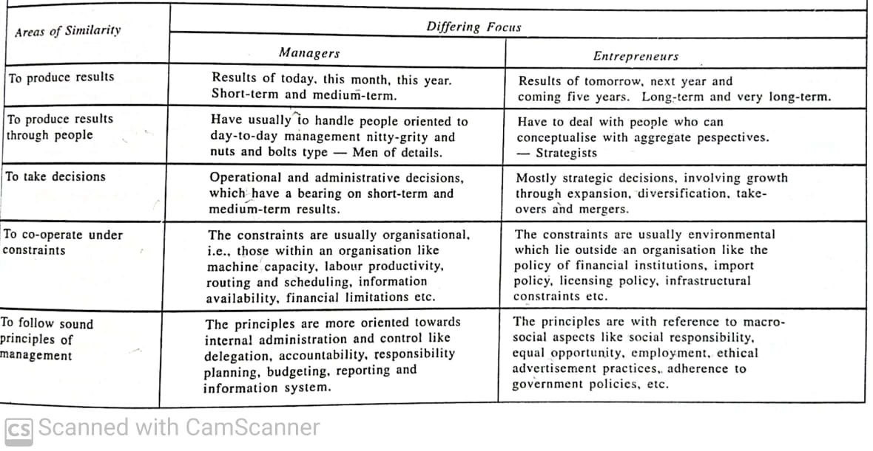
Managers and Entrepreneurs (Similarities)

Slide 35
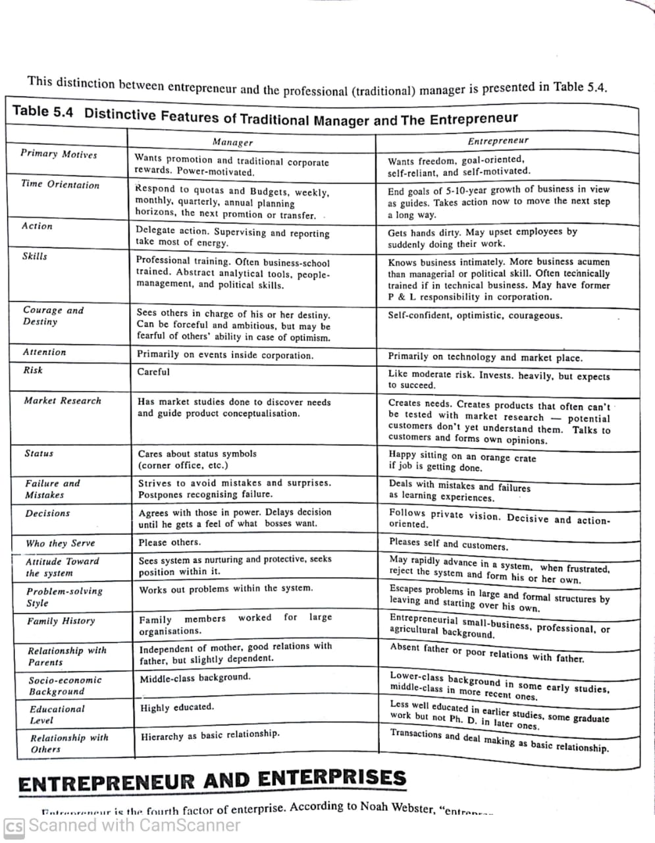








Managers Vs Entrepreneurs

Slide 36
Managers Vs Entrepreneurs

Slide 37
INTRAPRENEUR
An intrapreneur is a person who creates new ideas, products, or processes within a company, but does not own the business. They use the company’s resources to innovate.
Works inside an organization.
Thinks and acts like an entrepreneur.
Takes initiative and responsibility.
Uses company’s money, time, and resources.
Risk is mostly taken by the company, not by the individual.

Slide 38
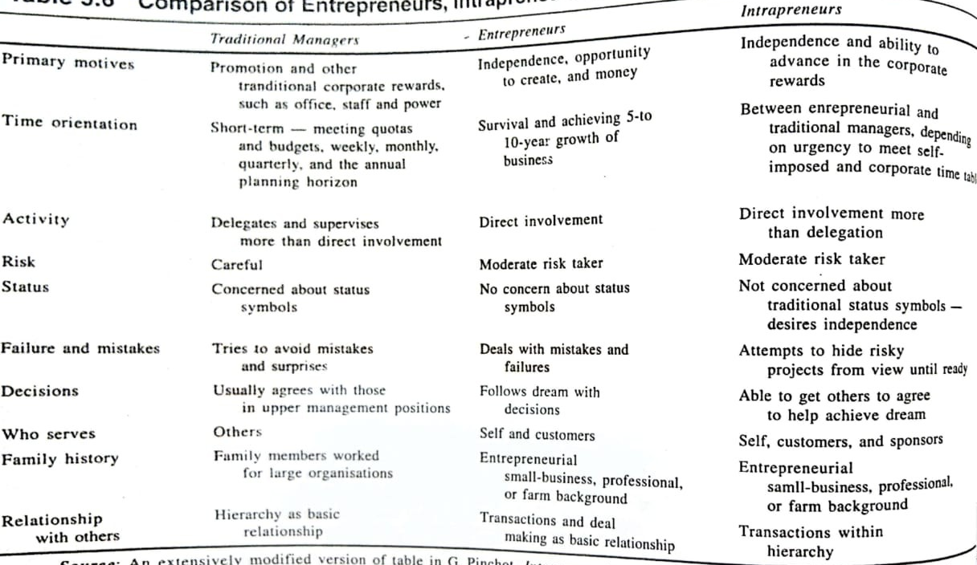
Comparison

Slide 39
CLASSIFICATION OF ENTREPRENEURS

Slide 40
According to type of business
Business entrepreneur
Trading entrepreneur
Industrial entrepreneur
Corporate entrepreneur
Agricultural entrepreneur

Slide 41
According to use of technology
Technical entrepreneur
Non-technical entrepreneur
Professional entrepreneur

Slide 42
According to motivation
Pure entrepreneur
Induced entrepreneur
Motivated entrepreneur
Spontaneous entrepreneur

Slide 43
Classification of entrepreneurs
Acc. to the type of business
Business entrepreneurs
A business entrepreneur is a person who starts and runs a business to earn profit by identifying customers’ needs and providing goods or services. Eg- Opening a retail shop and starting a restaurant
Trading entrepreneurs
These entrepreneurs are associated only with trading activities that is buying and selling only. They do not engage themselves with the manufacturing work. They undertake wholesale or retail trading activities. Eg-A mobile phone shop owner
Industrial entrepreneurs
These entrepreneurs are associated with the manufacturing process and industrial activities. These entrepreneurs may be involved in any large scale, medium scale or small scale industries. Eg-Cement manufacturing plant
Notes:
(

Slide 44
Corporate entrepreneurs
A person who works within a large company and brings new ideas, products, or processes. These entrepreneurs promote and establish corporate empires. They are successful at initiating and running corporate companies. Eg-An employee at Tata, Infosys, Google launching a new product
Agricultural entrepreneurs
Agricultural entrepreneurs are the entrepreneurs involved in agricultural and allied activities. A person who uses farming and agriculture in an innovative and business-oriented way. They can also be engaged in horticulture, animal husbandry, dairy farming etc.
Notes:
Gramophone works with farmers and provides them agronomy services and right inputs during the entire cropping cycle, at their doorstep.)

Slide 45
Classification of entrepreneurs
Acc. to the use of technology
Technical entrepreneurs
These entrepreneurs are technically sound and trained. They use their technical skills in establishing and improving the manufacturing units with latest level of technology. They highly influence the production technique.
Eg-A software engineer who starts a software company or app startup
Non-technical entrepreneurs
These entrepreneurs are not much concerned with the technical aspects of the entrepreneurship. They focus on evolving alternative strategies of marketing and distribution in order to promote their business.
Eg- A person opening a supermarket
Notes:
The founder and chairman of Bose Corp, Amar Bose passed away earlier this month. A graduate student from Massachusetts Institute of Technology (MIT), Bose was associated with the premiere tech school through his life. As a PhD student, and later as a professor and then professor emeritus, the idea of Bose Corp, set up in 1964, stemmed from his disappointment with the speakers in a stereo system that he bought as an MIT student that was the trigger for setting up Bose Corp in 1964. Bose Corp has, over the years, used the entrepreneur’s innovative research for some of the best known sound systems in the world. Furthering his company’s thought process, the entrepreneur was involved with many of the products that were seen in Bose’s stable, which included noise-canceling headphones as well as audio systems for cars.
McDonalds, Wenky's, Pizza Hut, Starbucks, Kelly Services, Zoom car- Rent A Car, Metropolitan Life Insurance

Slide 46
Professional entrepreneurs
-A professional entrepreneur is a person who starts a business using their professional knowledge, skills, or expertise. They usually belong to fields like law, medicine, engineering, accounting, architecture, consulting, IT, or design.
-They are not traditional traders or manufacturers — instead, they sell specialized services.
-Eg-A chartered accountant opening a CA firm
Notes:
WhatsApp was founded by Jan Koum and Brian Acton who had previously spent 20 years combined at Yahoo. WhatsApp joined Facebook in 2014
Kishore Biyani sold Big Bazaar, Central, Brand Factory, and Pentaloons etc to Reliance Ind. And Aditya Birla group.

Slide 47
Classification of entrepreneurs
Acc. to motivation
Pure entrepreneurs
A pure entrepreneur starts a business out of passion and inner desire, not because of pressure, government support, or compulsion.
Eg-A person who loves baking starts a bakery because it is their passion, not because they have no job or got a subsidy.
Spontaneous entrepreneurs
A spontaneous entrepreneur starts a business naturally and willingly, without any pressure or external support, because they see an opportunity. He is opportunity-driven and acts quickly on ideas.
Eg-Someone notices high demand for organic products and immediately starts an organic food store on their own.
Notes:
Example of sidhdharth
Case of bewakoof.com

Slide 48
Induced entrepreneurs
An induced entrepreneur starts a business because of external support or encouragement like government schemes, subsidies, tax benefits, or training programs. Motivation comes from outside in which government policies play a big role.
Eg- A person opens a small manufacturing unit after getting a government loan, subsidy, and training under a startup scheme.
Motivated entrepreneur
A motivated entrepreneur starts a business to achieve personal goals like earning more money, gaining social status, or becoming successful. May be influenced by success stories.
Eg- A salaried employee starts an online business after seeing others become financially successful.

Slide 49
Acc. to growth
Growth entrepreneurs
Growth entrepreneurs start businesses in industries that are expected to grow steadily over time. Their aim is continuous and stable growth, not overnight success.
Ex: A person starts a software services company and gradually expands by adding more clients, employees, and branches over the years.
Super growth entrepreneurs
Super growth entrepreneurs achieve very fast and very high growth in a short time. Their businesses grow rapidly in size, profit, and market value.
Business shows enormous growth, Strong profitability, Good liquidity, effective use of borrowed funds to expand and often supported by investors or venture capital.
Ex: Founders of startups like Flipkart, Zomato, or Paytm—their companies grew extremely fast in revenue, customers, and valuation.
Notes:
It based, healthcare, jio

Slide 50
Classification of entrepreneurs
Acc. to stages of development
First-generation entrepreneurs
These entrepreneurs had not inherited any family business. They had established their own enterprises. They are self-made and lack any previous entrepreneurial experiences.
Second-generation entrepreneurs
Second generation entrepreneur are those entrepreneurs who inherit the family business firms and pass it from one generation to another.

Slide 51
Modern entrepreneurs
Starts a business by understanding current market trends. He changes products or services according to customer needs, Uses new technology, innovation, and ideas. Focuses on growth, creativity, and adaptability.
Ex: A person starting an online clothing store, food delivery app, or digital marketing agency based on today’s demand.
Classical entrepreneurs
Focuses mainly on earning profit. Runs the business in a traditional way. He is satisfied with stable income and survival also May or may not focus on growth or expansion.
Ex: A small grocery shop owner or traditional textile trader who runs the same business for many years without major changes.

Slide 52
Classification of entrepreneurs
Others
Social entrepreneurs
Women entrepreneurs
Innovating entrepreneurs
Adaptive/Imitating entrepreneurs
Fabian entrepreneurs
Drone entrepreneurs
Aspiring entrepreneurs
Family-Business Entrepreneur
Lifestyle entrepreneurs
E- entrepreneurs
Mompreneures
Professor entrepreneurs
IT Entrepreneurs
Intrapreneur
Notes:
For instance, when Bill Gates (who is one of the richest persons in the world) initiates philanthropic activities through his charitable foundation 'The Gates Foundation' such acts are claimed as social entrepreneurial because Bill Gates is also a social entrepreneur.
Through Tesla Motors, SolarCity, and SpaceX, Musk has become a pioneer of social entrepreneurship in the modern age, as he seeks to build accessible solutions to renewable energy and push the limits on space exploration for mankind.
Sanjit “Bunker” Roy had a privileged upbringing in India, in contrast to many Indians who live off of less than $1 per day. When Roy visited some of his country's rural villages, he had a life-altering experience and decided to find a way to improve the social-economic inequities in his country. He founded Barefoot College in 1972, a solar-powered college for the poor.
As co-founder and global ambassador of the Malala Fund, Shiza Shahid, manages business operations for Malala Yousafzai, the teenager who became the youngest winner of the Nobel Peace Prize in 2014.⁴﻿ Like Malala, Shahid was born in Pakistan. She initially reached out to Malala in 2009 and worked to organize a camp for her and other Pakistani girls. In 2012, Shiza flew to Malala's bedside after she was targeted and shot by the Taliban for promoting education for girls. Inspired by Malala's desire to continue campaigning for gender equality and education, Shahid decided to help Malala strategize her campaign. Shahid created the Malala Fund, which helps empower women and girls by advocating and spreading access to education.

Slide 53
Social entrepreneur
Entrepreneurs are innovative highly motivated and creative thinkers. When these attributes are combined with the drive to solve social problems, a ‘social entrepreneur’ is born. Thus, social entrepreneurs are individuals with innovative solutions to society’s most pressing social problems.
Eg: SELCO India – Provides affordable solar energy to rural areas.

Slide 54
Women entrepreneurs
Women entrepreneurs may be defined as the women or a group of women who initiate, organize and operate a business enterprise.
As the name of this type of entrepreneur suggests, it involves women at the forefront of entrepreneurship. Shri Mahila Griha Udyog Lijjat Papad is one such organization. They pride themselves in being a women’s organization —of the women, by the women, and for the women. It was started in 1959 with seven lady members with a borrowed sum of Rs.80 at Girgaum in Mumbai. Another typical example of this type of entrepreneur is Kiran Majumdar Shaw, whose entrepreneurial endeavour has been detailed out in a caselet.

Slide 55
Innovating entrepreneurs
He is one who introduces new goods, new method of production, discovers new market and reorganizes the enterprise. It is important to note that such entrepreneurs can work only when a certain level of development is already achieved and people look forward to change and improvement.
Eg: Paytm – Brought digital payments to common people.
Notes:
saregama

Slide 56
Adaptive/Imitating entrepreneurs
There are characterized by readiness to adopt successful innovations. Imitative entrepreneurs do not innovate the changes themselves; they only imitate techniques and technology innovated by others.
Such types of entrepreneurs are particularly suitable for the under-developed regions for bringing a mushroom drive of imitation of new combinations of factors of production already available in developed regions.
Eg: Flipkart – Adapted the Amazon-like model for India.
Notes:
motorola.,xiomi, oppo, bluetooth speakers

Slide 57
Fabian entrepreneurs
They are characterized by very great caution in experimenting any change in their enterprise. They imitate only when it becomes perfectly clear that failure to do so would result in a loss of the relative position in the enterprise.
They are very cautious and adopt changes slowly, only when necessary.
Eg: Many traditional textile or family manufacturing businesses that moved to online selling only after competition increased.
Drone entrepreneurs
These are characterized by a refusal to adopt opportunities to make changes in production formula even at the cost of severely reduced returns relative to other like producers. Such entrepreneurs may ever suffer losses but they are not ready to make changes in their existing production methods.
Aspiring entrepreneurs
-An aspiring entrepreneur is a person who wants to start their own business and is preparing for it, but has not started yet.
-Eg: A person doing market research for a future business idea
Notes:
Indian rural agricultural entrepreneurs
Jewellery business

Slide 58
Family-Business Entrepreneur
Family-business entrepreneurs are the followers of family tradition role models. A typical example is that of Aditya Vikram Birla (1944-1995), who created about 75 factories for his business group in a career span of 25 years. Aditya Birla was the son of industrialist Basant Kumar Birla (popularly known as BK). His group is now known after him (Aditya Birla Group) and managed by his son Kumar Mangalam Birla.
Lifestyle entrepreneurs
These entrepreneurs take business as an integral part of their life. Usually, the family enterprise and business.
They start businesses to maintain a desired lifestyle, not for big growth.
Eg: Travel vloggers

Slide 59
Opportunist entrepreneurs
-As the name suggests, this kind of entrepreneur is an individual who has identified a technology-based opportunity and, while initiating and managing a small technology-based venture, either has little or no technical experience or whose previous occupational experience was within non-technical organizations.
-For example, Azim Hasham Premji inherited Wipro from his father, who was into oil business. Later, Premji realized the potential of information technology and ventured into this business. Rest is history as Wipro is today known as one of India’s IT powerhouses.
E- entrepreneurs
-These are people who start and run businesses online. They use the internet to sell products or services.
-Ex: Someone running an online clothing store, digital marketing agency, or a YouTube channel that earns money.
Mompreneures
-These are mothers who run their own businesses while taking care of their family. They choose flexible work so they can balance home and business.
-Ex: A mother selling homemade food, running an online boutique, or teaching online classes from home.

Slide 60
Professor entrepreneurs
-These are teachers or professors who start businesses using their knowledge and expertise.
Ex: A professor starting a coaching institute, publishing online courses, or doing consultancy work.
IT Entrepreneurs
-These are entrepreneurs who start businesses in the technology or IT field.
Ex: Someone launching a software company, mobile app, website development firm, or AI startup.
Intrapreneur
-An intrapreneur works inside an existing company, not their own business. They think and act like an entrepreneur but use the company’s resources.
Ex: An employee who creates a new product or idea for their company and helps it grow.

Slide 61
Women Entrepreneurs
Of the 58.5 million entrepreneurs in India, nearly 14% are women.
Indian women-owned businesses provide employment for 13.45 million people.
About 1/3 of Indian women entrepreneurs work in the agriculture sector, after that in manufacturing and retail trade.
In 2017, only 2% of startup funding went to a woman founder.
The top 10 fund raises of 2017 added up to $8.5 billion. The top 10 fund raises by a female-led startup accounted for only $136 million.
It is observed that Women entrepreneurs in India contribute a lot to jobs and business, but their number is still low, and they receive much less funding compared to men.

Slide 62
Women Entrepreneurs
A 2015 study by McKinsey Global Institute shows India's GDP could rise by between 16-60% by 2025 if women participated equally with men in the economy. Projections show that this could mean a whopping $2.9 trillion added to the economy. Actually, grew upto 40% in 2023-24.
30% of India's tech workforce is female. Although, 51% of entry-level jobs in India's IT industries are women, indicating that women are leaving at junior and mid-levels.
Radhika Aggarwal e-commerce marketplace ShopClues in 2011 made history as India’s first female co-founder of a billion-dollar company.

Slide 63
The low literacy rate (40%), low work participation rate (28%) and low urban population share (10%) of women as compared to 60%, 52%, and 18% respectively of their male counterparts well confirm their disadvantageous position in the society.

Slide 64
Segments of Women Entrepreneurs
Self-help groups
-These are groups of women who come together to support each other financially. They get loans, training, and guidance from microfinance institutions or banks. Mostly run small businesses like handicrafts, food products, etc.
-Main purpose is Self-employment and financial independence.
Grassroot Entrepreneurs
-These women start businesses mainly to support their family income. They work to improve their children’s education and future. Businesses are usually very small and local. Examples: tailors, flower sellers.
-Main purpose is Survival and family welfare.
Mid-rung Entrepreneurs
-These women are more ambitious and growth-oriented. They want to build a reputation, become well-known, and improve product quality. They enjoy creativity and innovation in their work. Businesses are usually medium-scale.
- Purpose is Recognition, creativity, and business growth.
Upper crust
-These women come from high social and economic backgrounds. They are well-educated and confident. Have better access to money, networks, and technology. Run large or professional businesses like export houses or pharmaceutical trading firms.
-Purpose is Expansion, profit, and leadership in business.

Slide 65
Psycho-social Barrier
Poor self-image of women
Inadequate motivation
Discriminating treatment
Faulty socialization
Role conflict
Cultural values
Lack of courage and self-confidence
Inadequate encouragement
Lack of social acceptance
Unjust economic, social and cultural system
Lack of freedom of expression
Afraid of failures and criticism
Susceptible to negative attitudes
Non-persistent attitude
Low dignity of labor
Lacking in leadership qualities

Slide 66
Sickness in small scale industries
A sick industrial unit may be defined as one when it fails to generate surplus on a continuous basis and depend on frequent infusion of external funds for its survival .
According to the Reserve Bank of India (RBI), a small-scale unit is sick, if It suffered cash loss in the previous year, and It is likely to suffer cash loss in the current year also, and Because of continuous losses, 50% or more of its net worth (owner’s capital) has been wiped out.

Slide 67
Causes of sickness A. Internal Causes
Planning
Technical Feasibility
Inadequate technical know-how
Location disadvantage
Outdated production process
Economic viability
High cost of inputs
Break-even point too high
Uneconomic size of project
Under-estimation of financial requirements
Unduly large investments in fixed assets

Slide 68
Implementation
Cost overruns resulting from delays in getting government licenses and approvals etc.
Inadequate mobilization of finance (fails to arrange sufficient funds)
Production
Production management
Inappropriate product-mix (product not match market demand or too much varieties of product)
Poor quality control
Poor capacity utilization
High cost of production
Inadequate maintenance and replacement

Slide 69
4) Labor management
High wage structure
Inefficient handling of labor problems
Excessive manpower
Poor labor relations
Poor labor productivity
5) Marketing management
Poor sales realization
Defective pricing policy
Weak market organization (less advertisement or customers are unaware about product)
Lack of market Feedback and market research

Slide 70
6) Financial management
Faulty costing (cost of production is not properly calculated)
Poor resource management
Liberal dividend policy
General financial indiscipline(no proper budgeting or proper records are maintained)
Poor liquidity
Deficiency of funds
Poor cash control
No plan “b”
Delaying debt
Borrowing blind
Ignoring lender like SIDBI(Small Industries Development Bank of India)

Slide 71
7) Administrative management
Over centralization
Lack of professionalism
Lack of feedback to management
Lack of controls
Lack of timely diversification (using new platforms, product divarication, technology and strategy adoption)
Excessive expenditure on R&D
Incompetent management
Dishonest management

Slide 72
Causes of sickness B. External Causes
Infrastructure bottlenecks
Non-availability/irregular supply of raw material
Chronic power shortage
Transport bottlenecks
Financial bottlenecks
Non-availability of adequate finance
Government controls and policies
Government price controls
Fiscal duties
Changes in government policies

Slide 73
Market constraints
Market Saturation (No many customers left to serve EG- every one is having mobile phones)
Revolutionary technological advancement
Extraneous factors
Natural calamities
Political situation (domestic as well as international)
War
Sympathetic strikes

Slide 74
(a) Delay in land acquisition and building construction
(b) Delay in obtaining financial as­sistance from public financial institutions
(c) De­layed supply of machinery by the manufacturers
(d) Problems related to recruitment of technical and managerial staff
(e) Delay on the part of the Government in sanctioning licenses, permits, etc.
(f) Shortages of basic inputs like power and coal. Other causes include

Slide 75
(g) Cost over-runs due to factors beyond the control of management
(h) Lack of demand for products or shift of demand to products of rival firms due to delays in project implementation
(i) Unsatisfactory performance by collaborators—financial and technical
(j) Large changes in the scale of operation and optimum product mix in the long run and, last but not the least
(k) Changes in the policy of the Government relating to movement of goods from one place to another within the country

Slide 76
Remedial Mechanism
Government Policy:
A number of measures have been taken to tackle the problem of industrial sickness. The importance of detection of sickness at the early stage has been emphasized by the RBI.
The policy framework in respect of measures to deal with the problem of industrial sick­ness has been laid down in the guidelines issued on October 1981 (which were subsequently modified in February 1982) for guidance of administrative ministries of the Central Government, State Governments and financial institutions.

Slide 77
The salient features of these guidelines are the following:
Role of Government Ministries
Government ministries will keep a close watch on industries that are becoming sick.
They will coordinate actions to revive such sick units. (coordinate with banks and other institution)
If many units in a particular industry are facing problems, the government may form special committees to deal with that industry. Can provide policy support, subsidies and etc.
Role of Financial Institutions
Banks improve their monitoring systems to spot financial trouble early (missed payments, falling sales, rising losses).
They will regularly collect reports from the companies they have funded. (profit and loss statement, cashflow and etc)
Directors appointed by banks on company boards will also send regular updates about the company’s working, decisions, and financial health.
All this information will be examined by IDBI (Industrial Development Bank of India).
IDBI will then share its findings with the concerned banks and the government so timely action can be taken such as financial support, restructuring loans, or revival plans.

Slide 78
1. Taking over management if sickness increases
If a company’s financial condition getting worse, banks and financial institutions may take responsibility for managing the company.
They will do this only if they believe the company can be made healthy again.
The Ministry of Finance will give clear rules on how banks should manage such sick companies.
2. If revival is not possible
If banks and financial institutions fail to stop the sickness or cannot revive the sick unit, then they will try to recover their unpaid loans (dues) by following normal banking rules.
Before taking recovery action, banks must inform the Government.
The Government will then decide:
whether the company should be nationalized (taken over by the government), or
whether other options (like workers’ participation in management) can help revive the company.

Slide 79
Concessions:
The Government has also provided certain concessions to assist revival of sick units without direct intervention.
For example, the Government has amended the Income-tax Act in 1977 by addition of Section 72A by which tax benefit can be given to healthy units when they take over the sick units by amalgamation(merger), with a view to reviving them.
The tax benefit is in the form of carry forward of the business losses and unprovided depreciation of the sick companies by the healthy companies after amalgamation.
A scheme for provisions of margin money to sick units in the small-scale sector at soft terms to enable them to obtain necessary funds from banks and financial institutions to implement their revival scheme has been introduced from January 1, 1982.
Moreover, financial assistance in the form of long-term equity up to Rs. 15 lakh to units with a project cost not exceeding Rs. 10 lakhs at a nominal service charge of 1% is available to potentially viable sick SSI from the National Equity Fund.

Slide 80
Establishment of BIFR:
The Central Government has set up a Board for Industrial and Financial Reconstruction (BIFR) with effect from 12 January 1987 in pursuance of special provision of the Sick Industrial Companies (Special Provision) Act, 1985.
The role is a major step for intervening at an early stage and detecting, preventing, as well as taking ameliorative, remedial and such other measures which to be taken with respect to sick and potentially viable companies. Board for Industrial and Financial Reconstruction (BIFR) needs a relook in the face of a steep rise in the number of industries turning sick. BIFR was constituted to facilitate the revival of industries deemed sick. When an industry turns sick, BIFR acts as an operating agency (generally the lead financial institution having the largest loan exposure among the creditors) to devise a revival strategy proposal.

Slide 81
A sick industrial company has to report its sickness to BIFR, once its accumulated losses at the end of financial year exceed 50% of the peak net worth attained during the period of 4 years immediately preceding the financial year.
BIFR provides a forum where the agencies concerned are brought together for analysing, diagnosing and evolving a reasoned decision for revival, or otherwise of the sick industrial unit. The agencies concerned are:
Sick Industrial Unit
State Government
Banks and Financial Institutions
The concerned departments of the Central Government

Slide 82
Sick Industrial Companies Act (SICA), 1985, has invested BIFR with the following powers:
Potential sickness has to be reported to BIFR
Mismanagement of industrial units by any person can be looked into by BIFR and, the BIFR may direct that person to restore the losses; and
BIFR can initiate changes in management, amalgamation of the sick industrial company with any other healthy company, sale or lease of a part, or whole of the industrial unit, or whole of the industrial unit, or any other preventive/remedial measures.

Slide 83
Remedial Measures
Early detection of sickness. Establishment of a proper management information system for providing early warning signals from within.
Financial institutions and banks should initiate necessary corrective action for sick or prone to sickness units based on diagnostic studies.
Wherever possible, attempts should be made to restore sick units to financial health even if it requires divestment of sick units.
The setting up of BFIR appears a sound decision.
The management of a unit that has lost net worth entirely will not be allowed to manage that unit any more, but before branding the management as a bad one, all the aspects of the case ought to be examined.

Slide 84
Management responsible for mismanagement should not be allowed assistance from financial institutions even for new ventures, too, needs re-thinking.
It is important in any scheme of reconstruction of a sick unit, all the stake-holders bear sacrifices on equitable and just basis.
The important criterion for take-over of a sick unit by another company should be whether the company taking over the sick unit has skill, technology and finance to save it.
There is need for a fresh look at Section 72-A of Income-tax Act to remove the inhibition caused to companies taking over sick units by insistence on the part of income-tax authorities for prior full implementation of the revival schemes before tax benefits can accrue.

Slide 85
Debt-equity ratio ought to be realistic.
Incentives should be provided to professional managers helping in reviving sick units.
Treatment of capital-intensive units prone to sickness has to be on a different footing than tackling of sickness in industry in general.

Slide 86
Entrepreneurial Environment
Political
Political atmosphere
Quality of leadership
Economical
Economic policies
Labour
Trade
Tariffs
Incentives
Subsidies
Social
Consumer
Labour
Attitude
Opinions
Motives
Technological
Competition and risk
Efficiency
Productivity
Profitability
Legal
Rules and regulations
Cultural
Structure
Aspirations and values

